Slide 1
Tutorial on Automation Testing
Md Khan
Date: 01/26/17

Slide 2
Class Objective
a)How to sale yourself? ( Success is hidden here)
Tel me about yourself (*****)
Tel me about your last/ current project(*****)
SOP (Standard Operating Procedure) (*****)
b)What is the best technique to sale yourself?
Find out the questions on learning subjects
Make a note on those questions

Slide 3
Testing Type (Main)
Manual Testing
Testing
Automation Testing

Slide 4
What is manual testing?
Ans: Testing which is done by manually, I mean using human resource is called manual testing.
What is Automation testing?
Ans: Testing which is done by using automation testing tool is called automation testing.

Slide 5
Diversity of Testing ( Find at least 2 Qs.)
Browser Version
OS
Browser
IE 11
XP
IE 10
IE
Windows 7
IE 9
G. Chrome
Testing
Window 8
IE 8
M. Firefox
Window 10
Safari 7
Linux
Safari
Safari 8
Macintosh
Safari 9
Cross Platform
Cross Browser
Safari 10

Slide 6
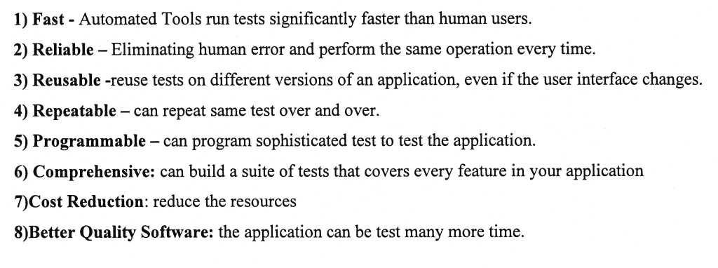
What are the advantages of Automation Testing?

Slide 7
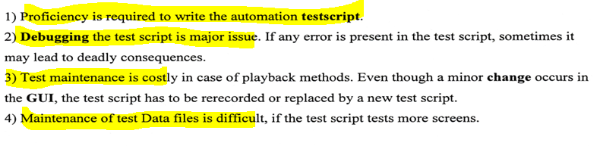
Disadvantages

Slide 8
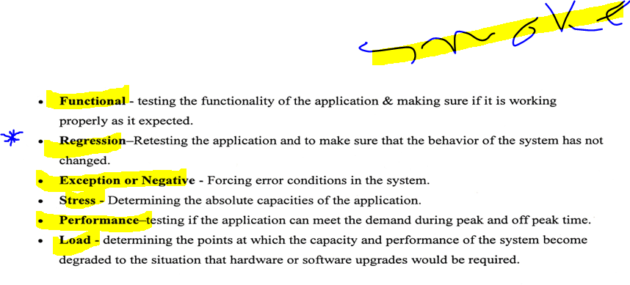
What type of Testing is done in test automation?
WE do Automation testing for regression testing
We do Automation testing for testing diversity

Slide 9
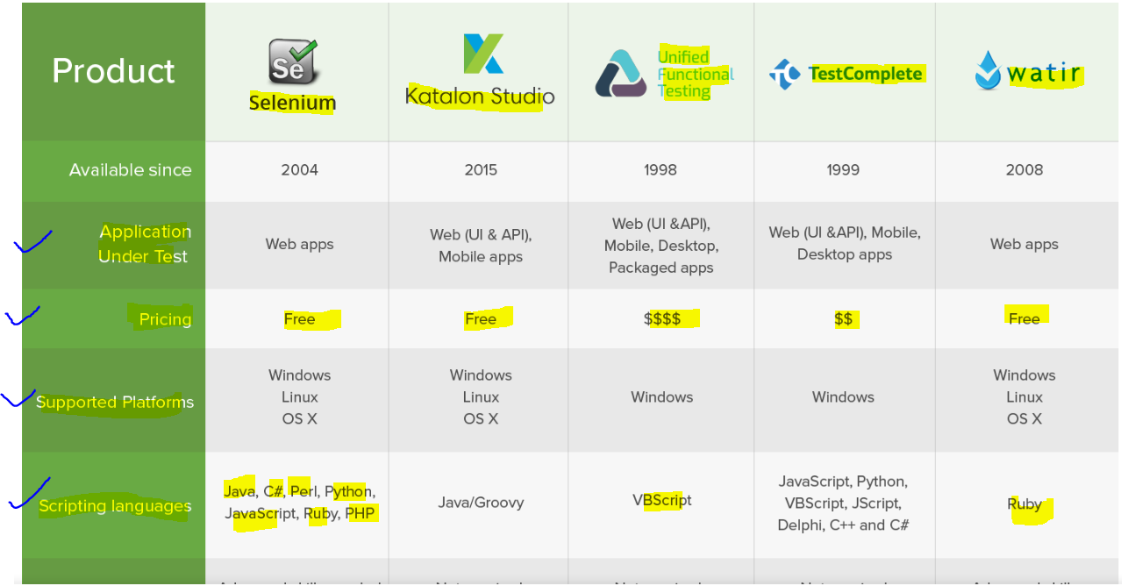
Some Automation Testing tool

Slide 10
Q1. What is Selenium?
a) Selenium is an open source Automation testing suites
Advantages:
a) Open source testing software
b) No license required
c) Environment platform independent
Exm: Windows, Linux, Macintosh

Slide 11
d) Versatile on browsers and programming languages
Exm:
Browser: IE , Mozilla Firefox, Google Chrome, Safari, Opera etc..
Note: IDE (Integrated Development Environment)
only support Mozilla Firefox browser
Language: Java, C#, Python, Ruby, PHP, Perl etc..

Slide 12
Limitations
Selenium supports testing of only web-based applications
Reports can only be generated using third-party tools like TestNG or JUnit.
As Selenium is a free tool, thus there is no ready vendor support though the user can find numerous helping communities.
The user is expected to possess prior programming language knowledge.

Slide 13
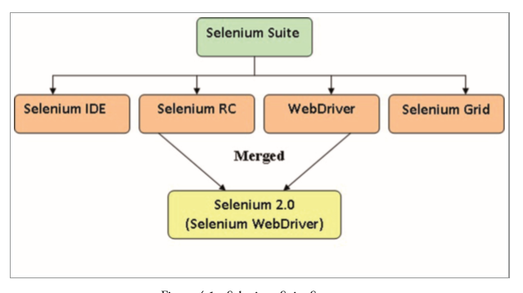
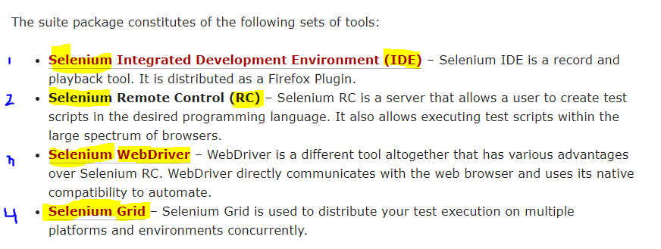
What are the Selenium Components?

Slide 14
About QTP/UFT
Applicable for web, windows and mobile applications
Provide integrated detail test result report
Support only vbs (Visual basic scripting) language
Lenience is required
Support test management tool QC/ALM
NB: If you have any problem with QTP/UFT you create a ticket with HP. HP will support you

Slide 15
Automation Testing
Process of Automation tester:
a) Select test case for automation
b) Develop test script
c) Enhance test script
d) Debug test script
e) Execute test script

Slide 16
Process of Automation tester cont..
f) Analyze test result
g) Defect entry
h) Check for test completion

Slide 17
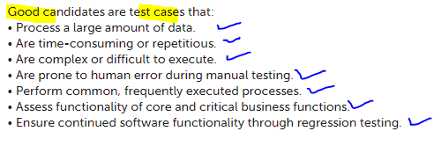
Good candidates Or Good test cases for Automation Testing
How do you select Automation test case?

Slide 18
You need to get preparation on
a) Java basics up to interface
b) How to develop and debug test automation scripts
c) Framework (Keyword driven, Data driven, Hybrid, POM )
d) How to make script robust (Synchronization, Exception handling)

Slide 19
Batch Execution and Reporting ( JUnit, TestNG, Maven, Jenkins)
Test management tool (JIRA, Cucumber)
Others (Manual, Database)
etc: File handling, Parameterization, make custom function, Data read from external source.

Slide 20
Objective
Learn all about QA based on live project.
ICTER Guru wants to develop an application to teach their students manual and automation testing based on live project.
Q. Is this possible to develop software without requirement?
Then what are the requirement here?
Who will collect the requirement? (BA)
From whom? ICTER Guru (Client)
For whom ? Khan GlobalTech ( Vendor)

Slide 21
Requirement (BRD)
BR1: Application should have a title.
BR2: Student should be able to input their first and last name.
BR3: Student should be able to select their gender
BR4: Student should be able to select their subjects.
BR5: Student should be able to select element locators from a dropdown list.
BR6: Student should be able to select web-element from a dropdown list.

Slide 22
What should the BRS?
BRS1: Application should have a title.
(ICTER Guru Automation Demo Application)
BRS2: Student should be able to input their first and last name.( Max character 12 digit)
BRS3: Student should be able to select their gender
(Male, Female and Others)
BRS4: Student should be able to select their subjects.
( Selenium, Database and GitHub)
BRS5: Student should be able to select element locators from a dropdown list.
(Id, Name, TagName, LinkText, PartialLinkText, Css, Xpath)
BRS6: Student should be able to select web-element from a dropdown list. (………………………………………………………………)

Slide 23
Q. What would be the best methodology for this project?

Slide 24
Who is client and stakeholder?
Ans: Here ICTERGURU is a Client and stakeholder
(A stakeholder is either an individual, group or
organization who is impacted by the outcome of a project).
Note: We provide our update to stakeholder, We present demo to stakeholder.

Slide 25
First Demo Application Based on 4 Requirements

Slide 26
Lets develop some scripts
Before that tell me,
I) What is command/Statement? Give me an example.
II) What is AUT? What is the difference among AUT, GUI, UI and Application?
III) How selenium execute statements? I mean execution sequence

Slide 27
IV) What are the most common components we use to develop a script?
What is the technique ? And what are the element locators?
If you want to understand the locators then you need to know about html little bit
I will let you know all together here.

Slide 28
Summary of today’s Class
i) How to sale yourself
II) How manual and Automation make testing comprehensive
III) Different automation testing tools and their objectives, uses and so on…
What to be learn in Automation perspectives
ICTER Guru demo applications.
HTML, Web elements and some operating methods

Slide 29
Objective of ICTER Guru Demo Application
What we want to do?
We want to know about:
a) Web elements in application
b) Different element locators
c) Different WebDriver methods and techniques
d) Correlation between manual and automation testing
e) Application workflow
f) Testing integration and development integration

Slide 30
g) Release and Build
h) Scripts development and debugging
i) Batch execution , Framework and Reporting
j) How to sale yourself ( Interview questions and answers)
Thanks!

